Slide 1
Indexing & Hashing
Chapter 12
Imran Siddiqi
imran.siddiqi@mcs.edu.pk
Computer Science Department
College of Telecommunication Engineering
National University of Sciences and Technology

Slide 2
Basic Concepts
Indexing mechanisms used to speed up access to desired data
  Index of a book
  Author catalog in a library
Search Key - attribute or set of attributes used to look up records in a file
Efficient Searching
  Direct record locating without sequential search
  Index Files: Data structures to organize records

Slide 3
Contents
Indexing
Ordered Indices
  Primary, Secondary, Sparse and Dense Indices
Hashing
  Static Hashing
Hashed Indices

Slide 4
Index Files
An index file consists of records (called index entries) of the form
Index files are typically much smaller than the original file
Two basic kinds of indices:
  Ordered indices: Search keys are stored in sorted order
  Hash indices: Search keys are distributed uniformly across “buckets” using a “hash function”.
search-key
pointer

Slide 5
Index Evaluation Metrics
Access types supported efficiently. E.g.,
  Records with a specified value in the attribute
  Records with an attribute value falling in a specified range of values.
Access time
Insertion time
Deletion time
Space overhead

Slide 6
Ordered Indices
Ordered index – Index entries are stored sorted on the search key value. E.g., author catalog in library.
Primary index: Search key specifies the sequential order of the file
  Also called clustering index
  The search key of a primary index is usually but not necessarily the primary key
Secondary index: Search key specifies an order different from the sequential order of the file.
  Also called non-clustering index

Slide 7
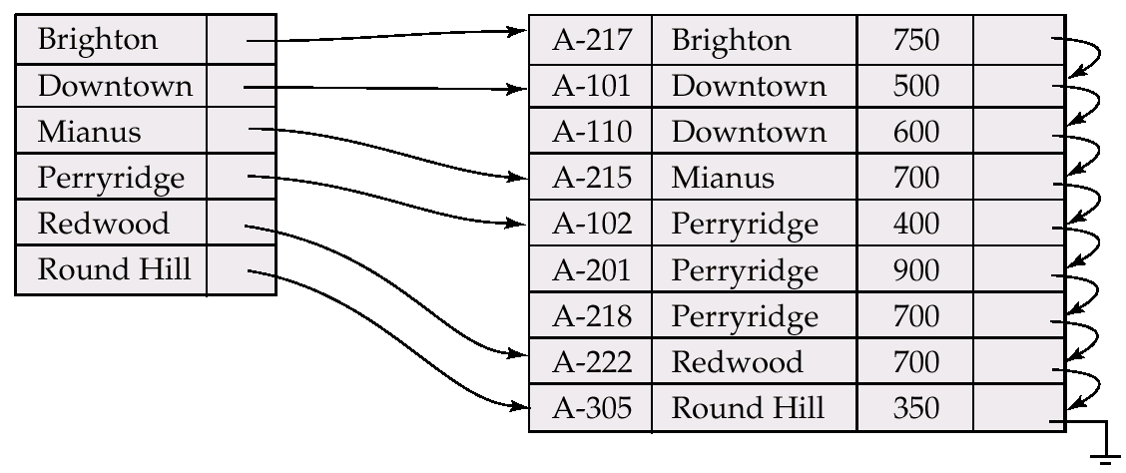
Dense Index Files
Dense index — Index record appears for every search-key value in the file

Slide 8
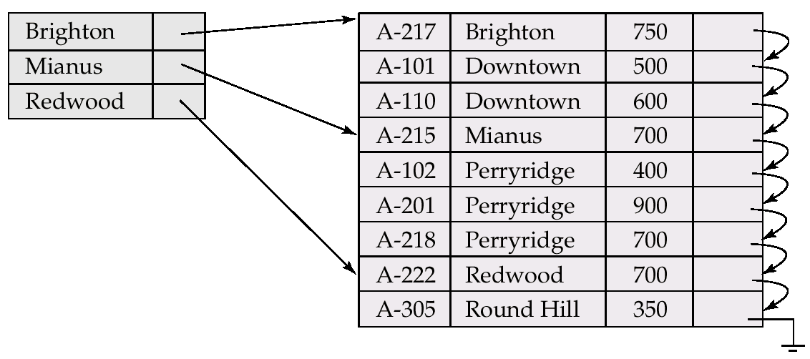
Sparse Index Files
Sparse Index: contains index records for only some search-key values

Slide 9
Sparse Index Files
Applicable when records are sequentially ordered on search-key
To locate a record with search-key value K we:
  Find index record with largest search-key value < K
  Search file sequentially starting at the record to which the index record points

Slide 10
Dense & Sparse Indices
Ashby, 25, 3000
Basu, 33, 4003
22
Bristow, 30, 2007
25
Ashby
30
Cass
Cass, 50, 5004
33
Smith
Daniels, 22, 6003
Jones, 40, 6003
40
44
Smith, 44, 3000
44
Tracy, 44, 5004
50
Sparse Index
Dense Index
Question 1
on
Data File
on
Name
Age
Which of these is Faster?
Answer
Dense Indices.

Slide 11
Dense & Sparse Indices
Ashby, 25, 3000
Basu, 33, 4003
22
Bristow, 30, 2007
25
Ashby
30
Cass
Cass, 50, 5004
33
Smith
Daniels, 22, 6003
Jones, 40, 6003
40
44
Smith, 44, 3000
44
Tracy, 44, 5004
50
Sparse Index
Dense Index
Question 1
on
Data File
on
Name
Age
Which of these has less space overhead?
Answer
Sparse Indices.

Slide 12
Secondary Indices
Frequently, one wants to find all the records whose values in a certain field (which is not the search-key of the primary index) satisfy some condition.
  Example 1: In the account database stored sequentially by account number, we may want to find all accounts in a particular branch
  Example 2: as above, but where we want to find all accounts with a specified balance
We can have a secondary index with an index record for each search-key value; index record points to a bucket that contains pointers to all the actual records with that particular search-key value
Secondary Indices have to be dense – WHY?

Slide 13
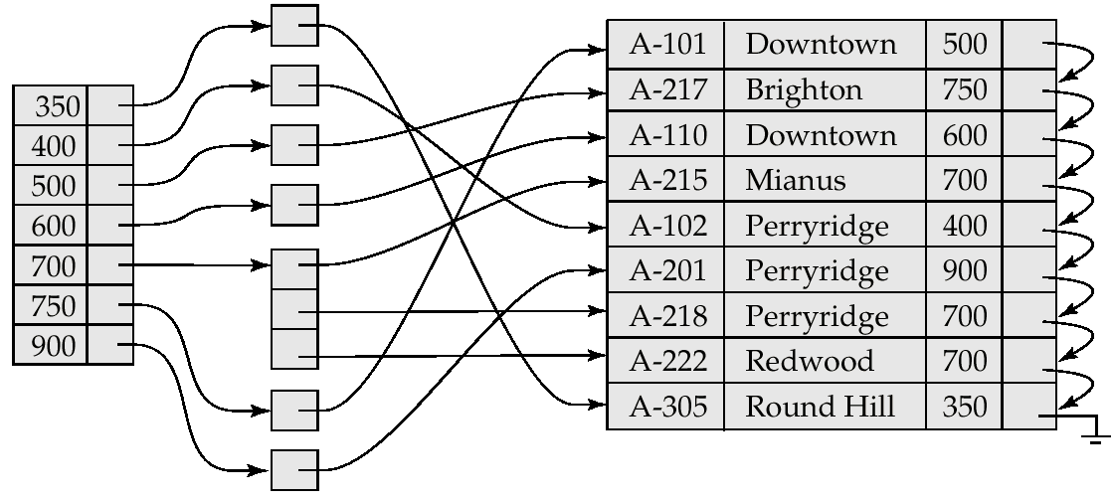
Secondary Indices
Secondary Index on balance field of account

Slide 14
Static Hashing
A bucket is a unit of storage containing one or more records
In a hash file organization we obtain the bucket of a record directly from its search-key value using a hash function
Hash function h is a function from the set of all search-key values K to the set of all bucket addresses B.
Hash function is used to locate records for access, insertion as well as deletion.
Records with different search-key values may be mapped to the same bucket; thus entire bucket has to be searched sequentially to locate a record.

Slide 15
Hash File Organization
Hash file organization of account file, using branch-name as key
  There are 10 buckets,
  The binary representation of the ith character is assumed to be the integer i.
  The hash function returns the sum of the binary representations of the characters modulo 10
  E.g. h(Perryridge) = 5 h(Round Hill) = 3 h(Brighton) = 3
h(k) mod M
# of buckets

Slide 16
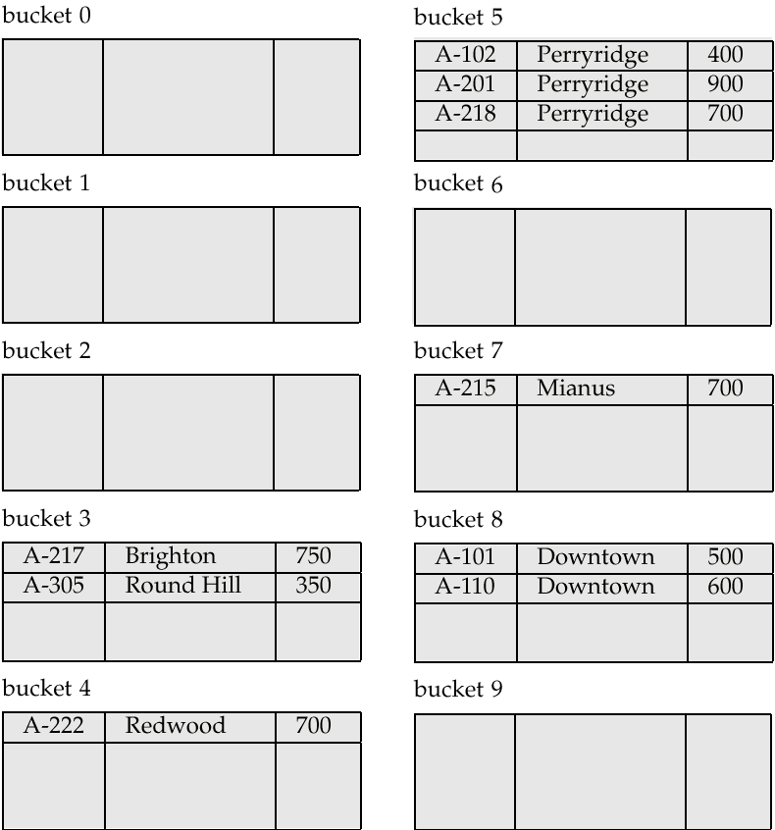
Hash File Organization

Slide 17
Hash Functions
Worst has function maps all search-key values to the same bucket; this makes access time proportional to the number of search-key values in the file.
An ideal hash function is uniform, i.e., each bucket is assigned the same number of search-key values from the set of all possible values.
Ideal hash function is random, so each bucket will have the same number of records assigned to it irrespective of the actual distribution of search-key values in the file.
Typical hash functions perform computation on the internal binary representation of the search-key.
  For example, for a string search-key, the binary representations of all the characters in the string could be added and the sum modulo the number of buckets could be returned. .

Slide 18
Handling of Bucket Overflows
Bucket overflow can occur because of
  Insufficient buckets
  Bucket Skew:
    Multiple records have same search-key value
    Chosen hash function produces non-uniform distribution of key values
Although the probability of bucket overflow can be reduced, it cannot be eliminated; it is handled by using overflow buckets.

Slide 19
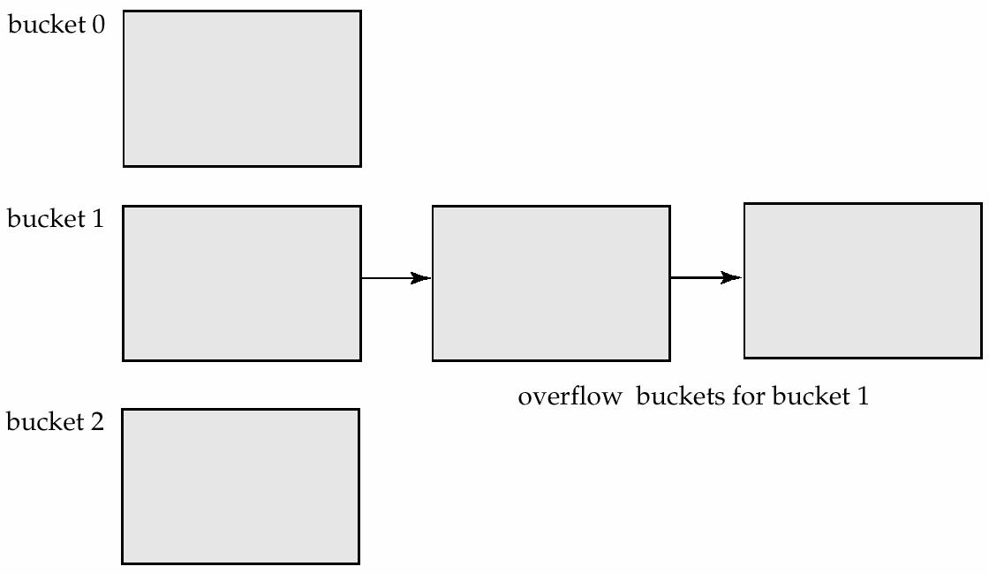
Handling of Bucket Overflows
Overflow chaining – the overflow buckets of a given bucket are chained together in a linked list
Above scheme is called closed hashing

Slide 20
Hash Indices
Hashing can be used not only for file organization, but also for index-structure creation.
A hash index organizes the search keys, with their associated record pointers, into a hash file structure
Note: if the file itself is organized using hashing, a separate primary hash index on it using the same search-key is unnecessary.

Slide 21
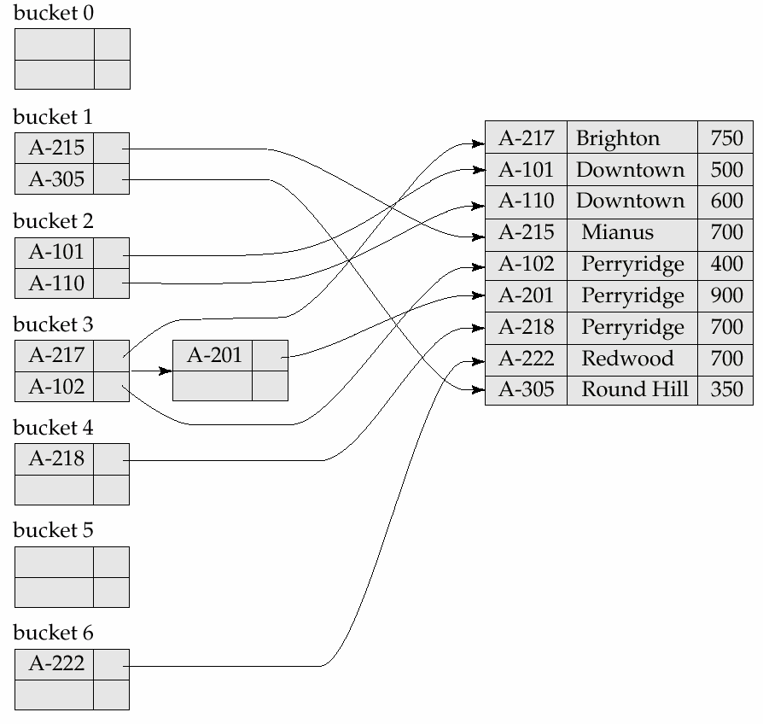
Hash Indices
Sum of Digits MOD 7

Slide 22
Static Hashing - Problems
In static hashing, function h maps search-key values to a fixed set of B of bucket addresses
  Databases grow with time. If initial number of buckets is too small, performance will degrade due to too much overflows.
  If file size at some point in the future is anticipated and number of buckets allocated accordingly, significant amount of space will be wasted initially.
  If database shrinks, again space will be wasted.
  One option is periodic re-organization of the file with a new hash function, but it is very expensive.
These problems can be avoided by using techniques that allow the number of buckets to be modified dynamically.

Slide 23
References
Chapter 12, Database System Concepts, Silberschatz, Korth, Sudarshan
Reading Material provided for this topic

